Slide 1

Introduction to Websites

Slide 2
What is a website and webpage?
It is legit just a document like any other document like a word document or PDF. It is just a Hyper Text Markup Language Document.

Slide 3
What makes it different then?
The fact that these are used to attract users to either for the application or information, it needs to be,
Lightweight
Appealing
Simple

Slide 4
SO WHAT is used in this Web Document?
Most of the websites are made using HTML, CSS and JavaScript.
Each of these help in their own way,
HTML is used for accumulating all the elements
CSS is used to style these HTML elements
JavaScript is primarily used for creating an interactivity with the users.

Slide 5
Let’s SEE Some OF OUR FAVOURITE SITES

Slide 6
Sites we’ll Be Making

Slide 7
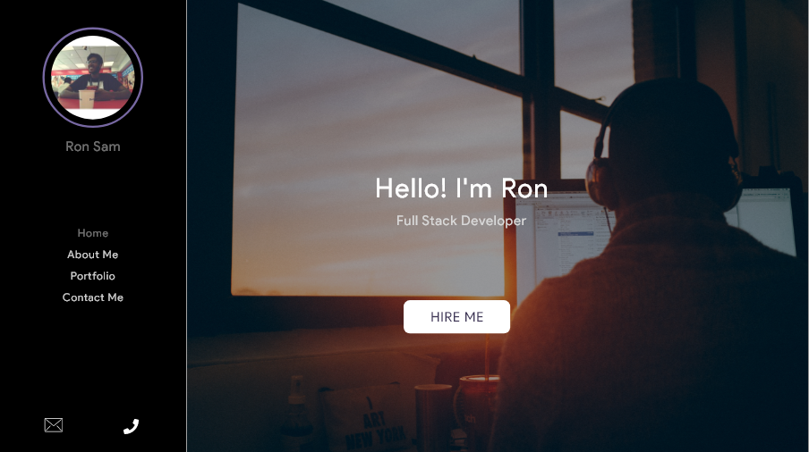
Portfolio
Portfolio Site
Clean UI
Internal and External Navigation
Ready to use

Slide 8
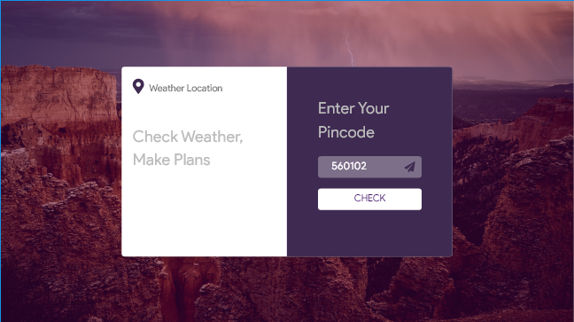
Weather App
Weather Application
Clean UI
REST API calls
Ready to use

Slide 9
TIME TO MAKE OUR SITE

